Slide 1
Single Transmission of a Plane Wave through a Periodic Slab
Pierre Margerit, June 2024

Slide 2

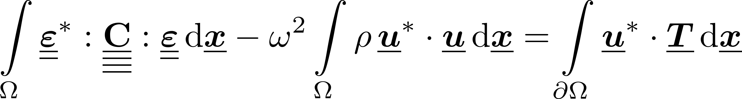
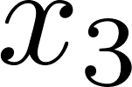
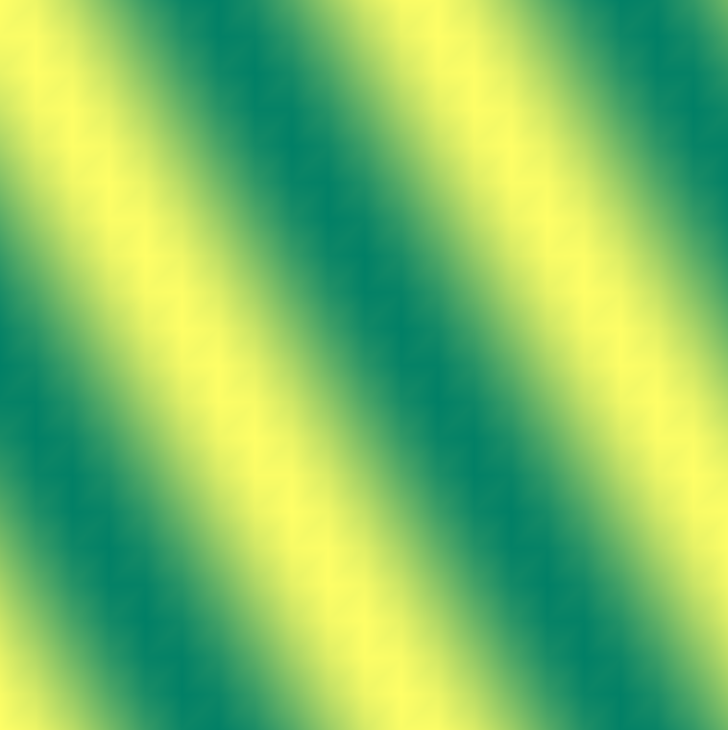
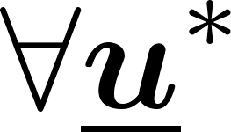
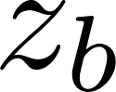
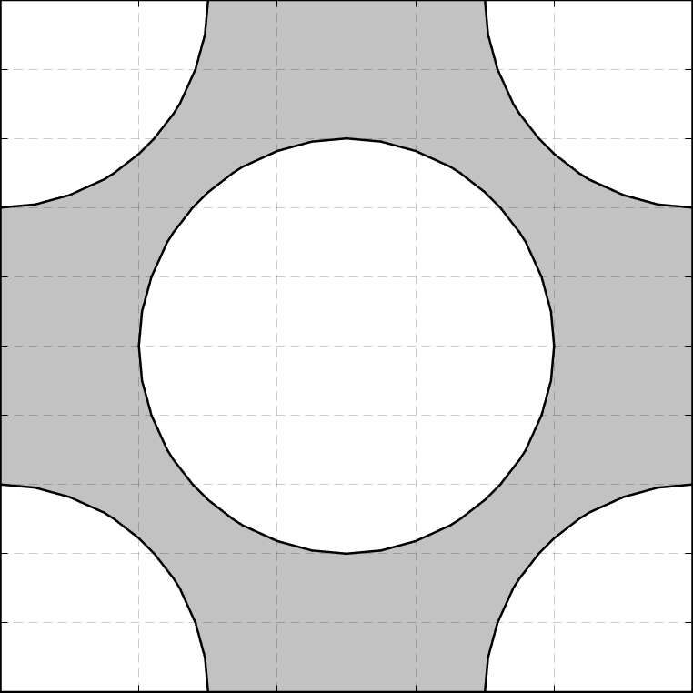
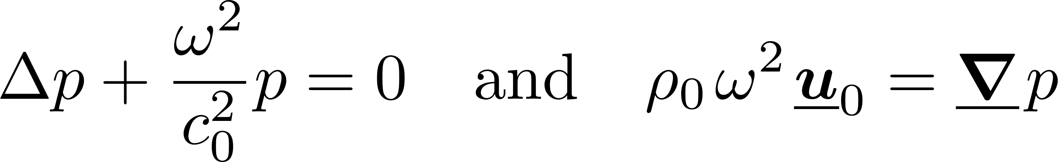
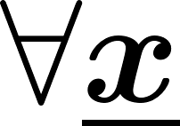

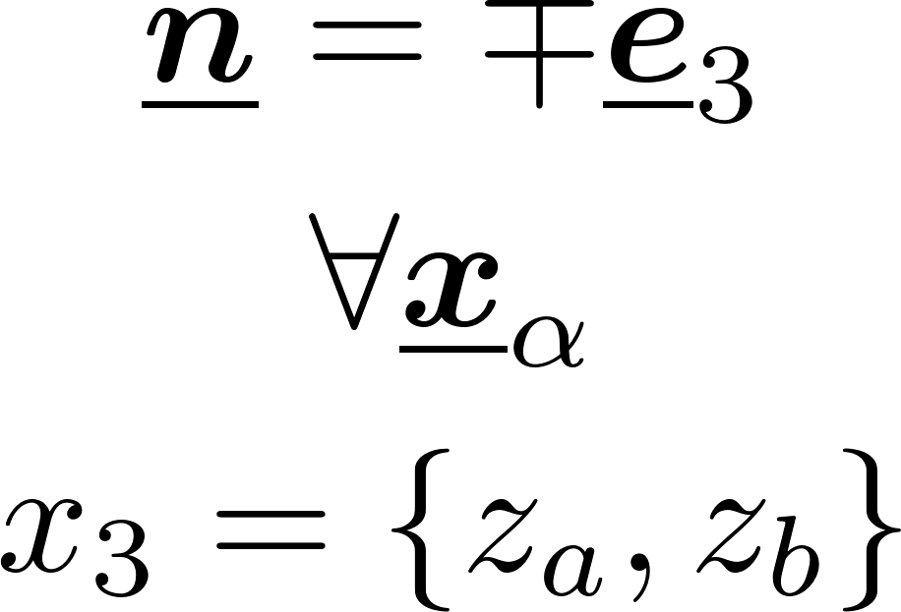
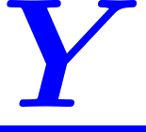
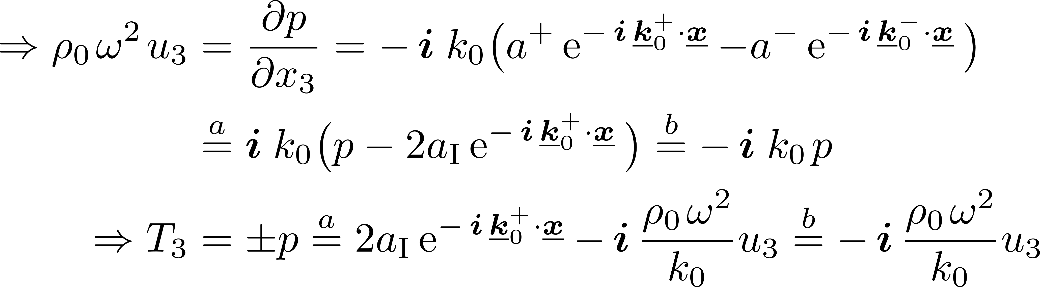
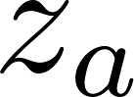
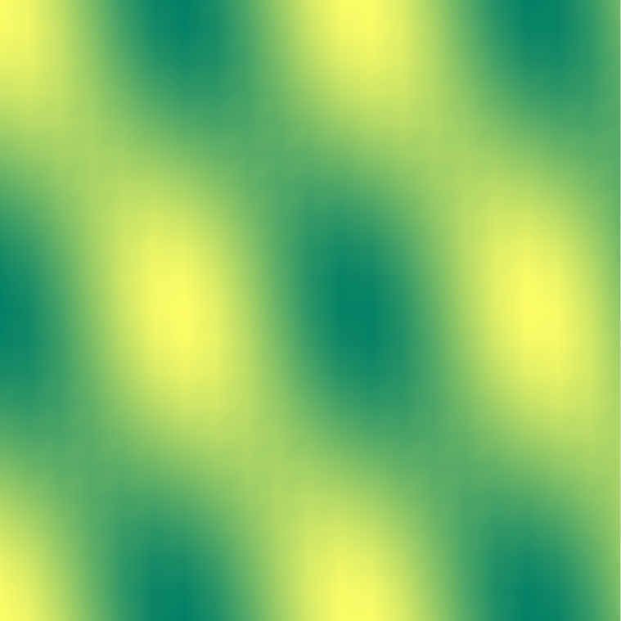


Problem setting
Equations
Solid domain
Fluid domain
Interfaces

Slide 3
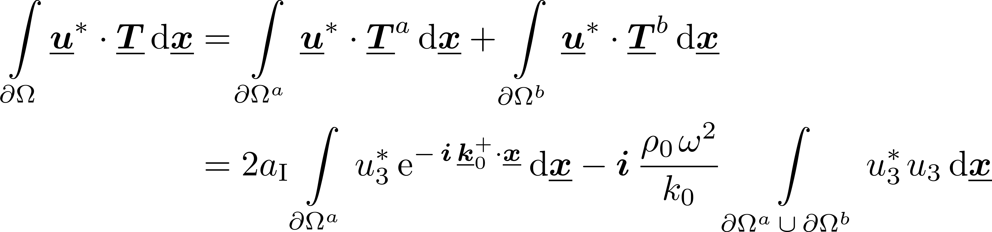
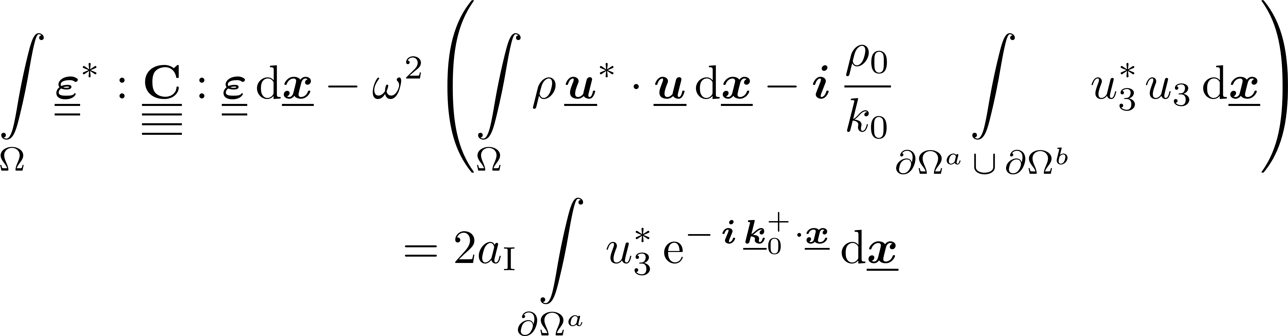
Acoustic Impedance
Including the acoustic radiation in boundary conditions …
… slightly modifies the variational formulation
At the end:

Slide 4
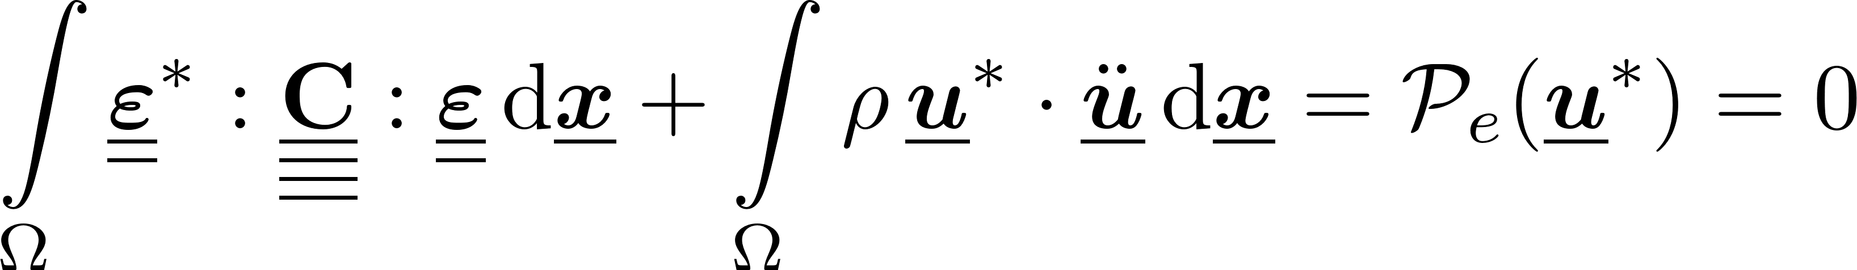
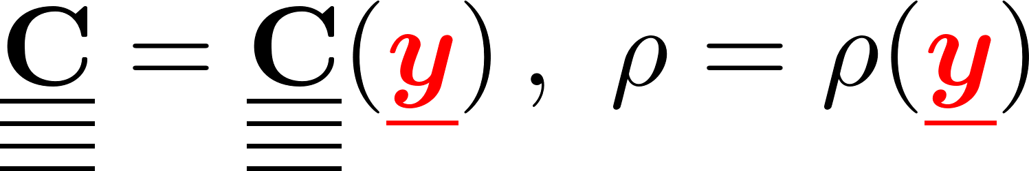
Problem setting
Governing equations of motion
Scale separation:
Microscopic unit cell:
Macroscopic grid:
Material properties:
Separed equations:
Free motion

Slide 5
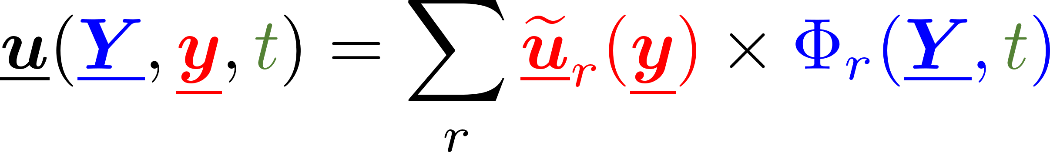
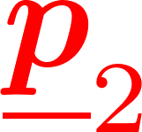
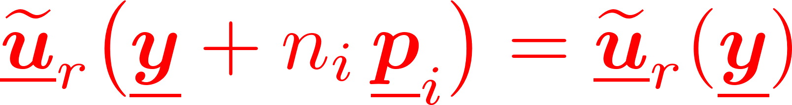

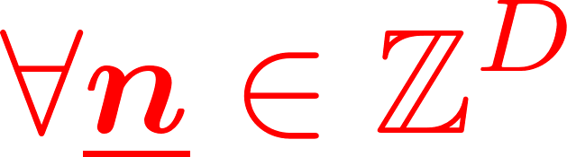

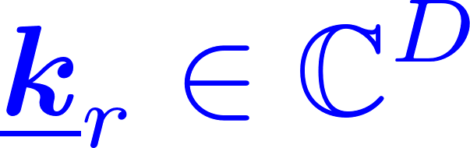
Two-scale media: separed solutions
Assuming separable solutions
Periodicity of the corrector: guarantees the C⁰-continuity
Elementary solutions: macroscopic plane wave
microscopic corrector
macro
time
micro
macroscopic modulation
periodicity vectors
‘‘Bloch Waves’’
pulsation
wavenumber

Slide 6
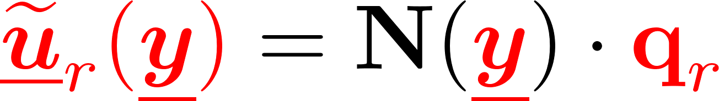
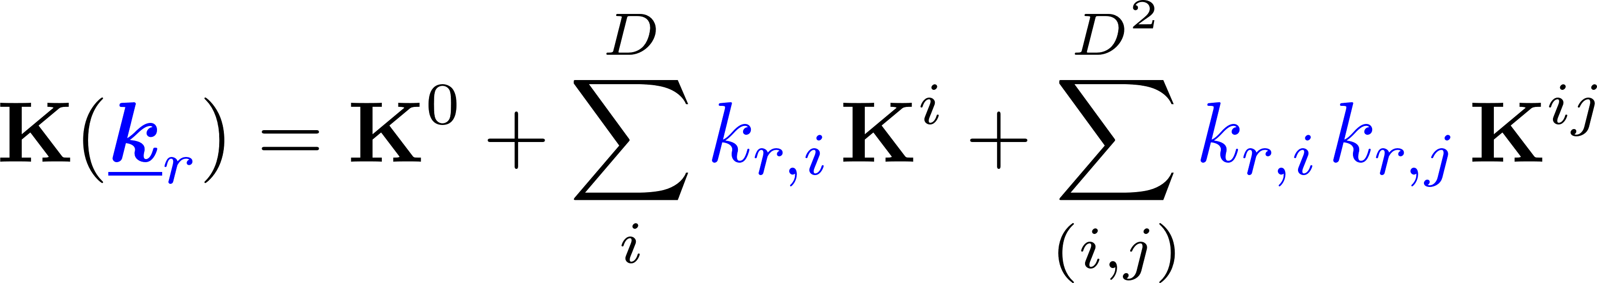
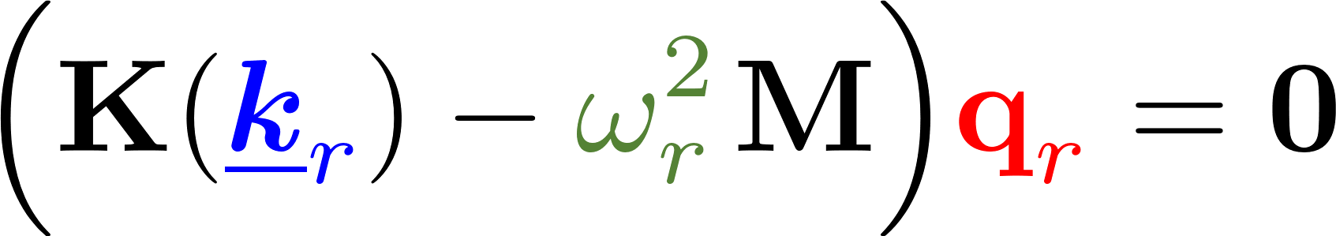
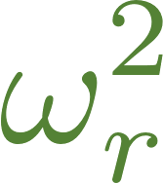
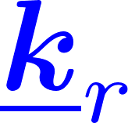
Bloch Wave Analysis
Separed gradient
Unit-cell local equations:
With a given discretization
The spectrum of Bloch Waves associated to a specific unit cell corresponds to the solutions of a Generalized Eigenvalue Problem in parametrized by
where

Slide 7
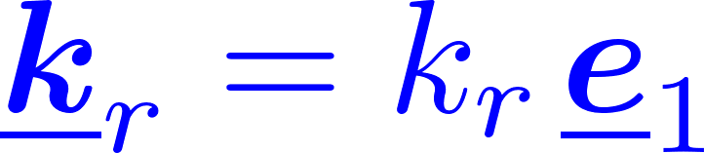
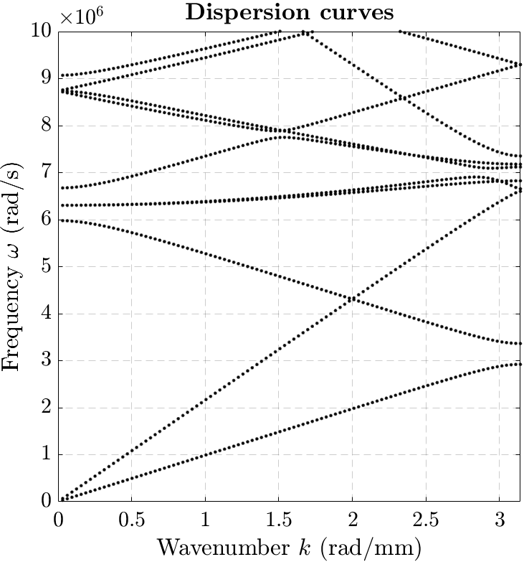

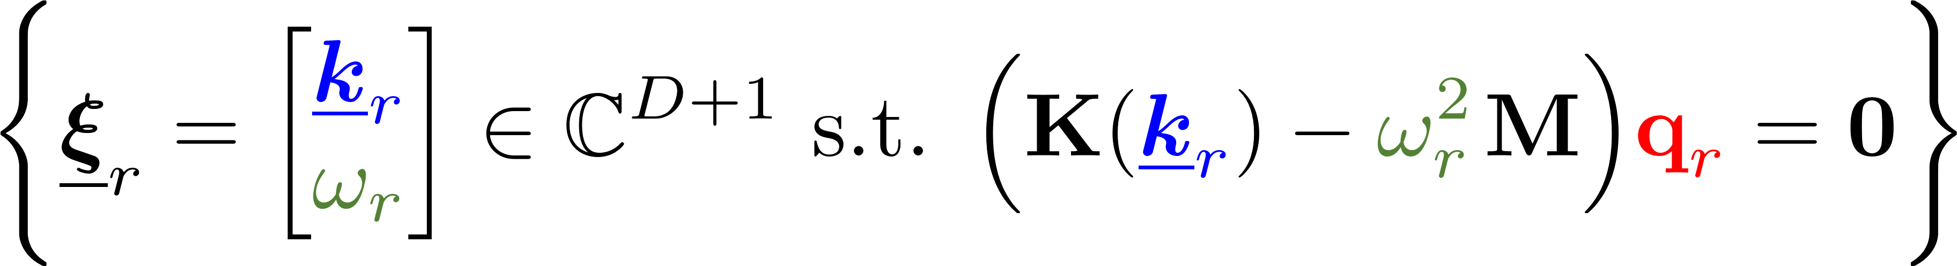
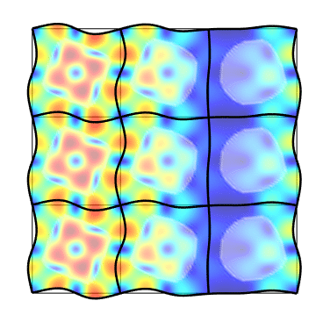
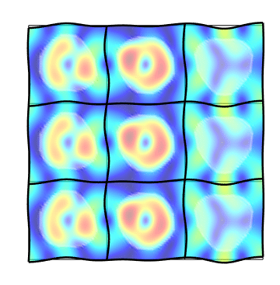
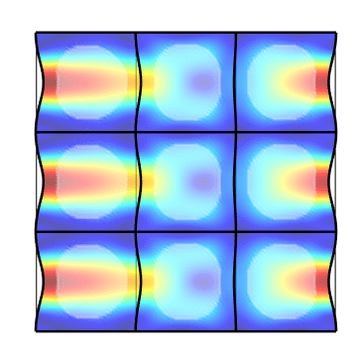
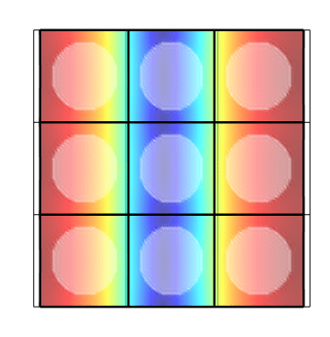
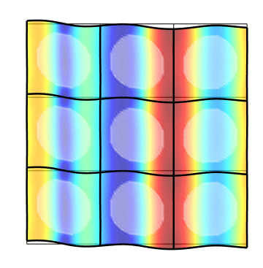
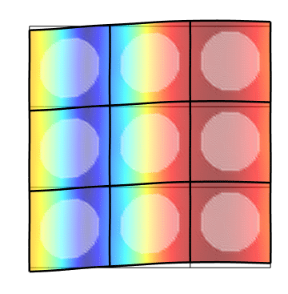
Bloch Wave Spectrum
Dispersion curves (or hypersurfaces)
In practice:
Define the unit cell (phase properties & distribution)
Build the sytem matrices K0, K1, K2, M
For kr in [kmin … kmax] extract the R smallest eigenvalues omegar
High computing cost !
Looks like low-order curves…

